Slide 1
INTRODUCTION
Fuzzy Logic: Fuzzy sets
basic operations
membership functions
Fuzzy Inference
Fuzzification
Fuzzy Rule Based System
Defuzzification

Slide 2
Definition of Fuzzy Logic.
The word ‘Fuzzy’means
difficult to perceive; indistinct or vague.
Ex: "the picture is very fuzzy"
‘Fuzzy Logic’means
Fuzzy logic is a form of many-valued logic in which the truth values of variables may be any real number between 0 and 1.
Fuzzy Logic resembles the human decision-making methodology and deals with vague and imprecise information.
A type of logic used in computers and other electronic devices for processing imprecise or variable data: in place of the traditional binary values, fuzzy logic employs a range of values for greater flexibility.
Word origin of 'fuzzy logic' < fuzzyset, coined (1965) by L. A. Zadeh, U.S. computer scientist.

Slide 3
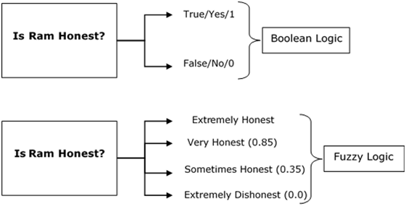

Slide 4
Classical Sets
Fuzzy set is also a type of ‘set’ but it is somehow quite different from Classical set.
Classical set is an unordered collection of different elements. It can be written explicitly by listing its elements using the set bracket.
The Classical set is defined by specifying a property that elements of the set have in common. The set is described as A = {x:p(x)}
Example 1 − The set {a,e,i,o,u } is written as
A = {x:x is a vowel in English alphabet}
Example 2 − The set {1,3,5,7,9} is written as
B = {x:1 ≤ x < 10 and (x%2) ≠ 0}
If an element x is a member of any set S, it is denoted by x∈S and if an element y is not a member of set S, it is denoted by y∉S.
Example − If S = {1,1.2,1.7,2},1 ∈ S but 1.5 ∉ S

Slide 5
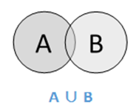
Basic operations on Classical Set
Union
The union of sets A and B (denoted by A ∪ B) is the set of elements which are in A, in B, or in both A and B.
Hence, A ∪ B = {x|x ∈ A OR x ∈ B}.
Example − If A = {10,11,12,13} and B = {13,14,15}, then A ∪ B = {10,11,12,13,14,15} – The common element occurs only once.

Slide 6
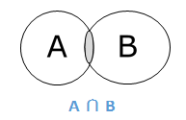
Intersection
The intersection of sets A and B (denoted by A ∩ B) is the set of elements which are in both A and B.
Hence, A ∩ B = {x|x ∈ A AND x ∈ B}.

Slide 7
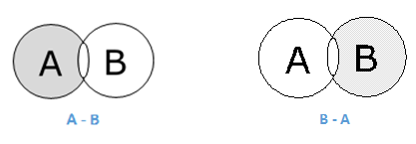
Difference/ Relative Complement
The set difference of sets A and B (denoted by A–B) is the set of elements which are only in A but not in B.
Hence, A − B = {x|x ∈ A AND x ∉ B}.
Example − If A = {10,11,12,13} and B = {13,14,15}, then (A − B) = {10,11,12} and (B − A) = {14,15}. Here, we can see (A − B) ≠ (B − A).

Slide 8
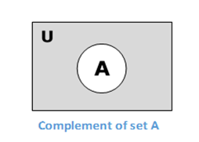
Complement of a Set
The complement of a set A (denoted by A′) is the set of elements which are not in set A.
Hence, A′ = {x|x ∉ A}.
More specifically, A′ = (U−A) where U is a universal set which contains all objects.
Example − If A = {x|x belongs to set of add integers} then A′ = {y|y does not belong to set of odd integers}.

Slide 9
Fuzzy Sets
Fuzzy sets can be considered as an extension and gross oversimplification of classical sets.
It can be best understood in the context of set membership.
Basically it allows partial membership which means that it contain elements that have varying degrees of membership in the set. From this, we can understand the difference between classical set and fuzzy set.
Classical set contains elements that satisfy precise properties of membership while fuzzy set contains elements that satisfy imprecise properties of membership.

Slide 10
Membership Function
In fuzzy logic, it represents the degree of truth as an extension of valuation.
Degrees of truth are often confused with probabilities, although they are conceptually distinct, because fuzzy truth represents membership in vaguely defined sets, not likelihood of some event or condition.
Zadeh, in his theory of fuzzy sets, proposed using a membership function (with a range covering the interval (0,1)) operating on the domain of all possible values.

Slide 11
Mathematical Concept
For any set X, a membership function on X is any function from X to the real unit interval [0,1].
Membership functions on represent fuzzy subsets of X.
The membership function which represents a fuzzy set Ã is usually denoted by µ_{A.}
For an element x of X, the value µ_{A}(x) is called the membership degree of x in the fuzzy set Ã. The membership degree µ_{A}(x) quantifies the grade of membership of the element x to the fuzzy set Ã.
The value 0 means that x is not a member of the fuzzy set; the value 1 means that x is fully a member of the fuzzy set.
The values between 0 and 1 characterize fuzzy members, which belong to the fuzzy set only partially.

Slide 12
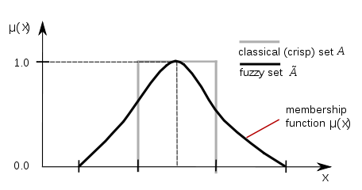
Membership function of fuzzy set

Slide 13
Features of Membership Functions
Core
For any fuzzy set Ã , the core of a membership function is that region of universe that is characterize by full membership in the set. Hence, core consists of all those elements x of the universe of information such that,
µ_{A} = 1
Support
For any fuzzy set Ã, the support of a membership function is the region of universe that is characterize by a nonzero membership in the set. Hence core consists of all those elements x of the universe of information such that,
µ_{A} > 0

Slide 14
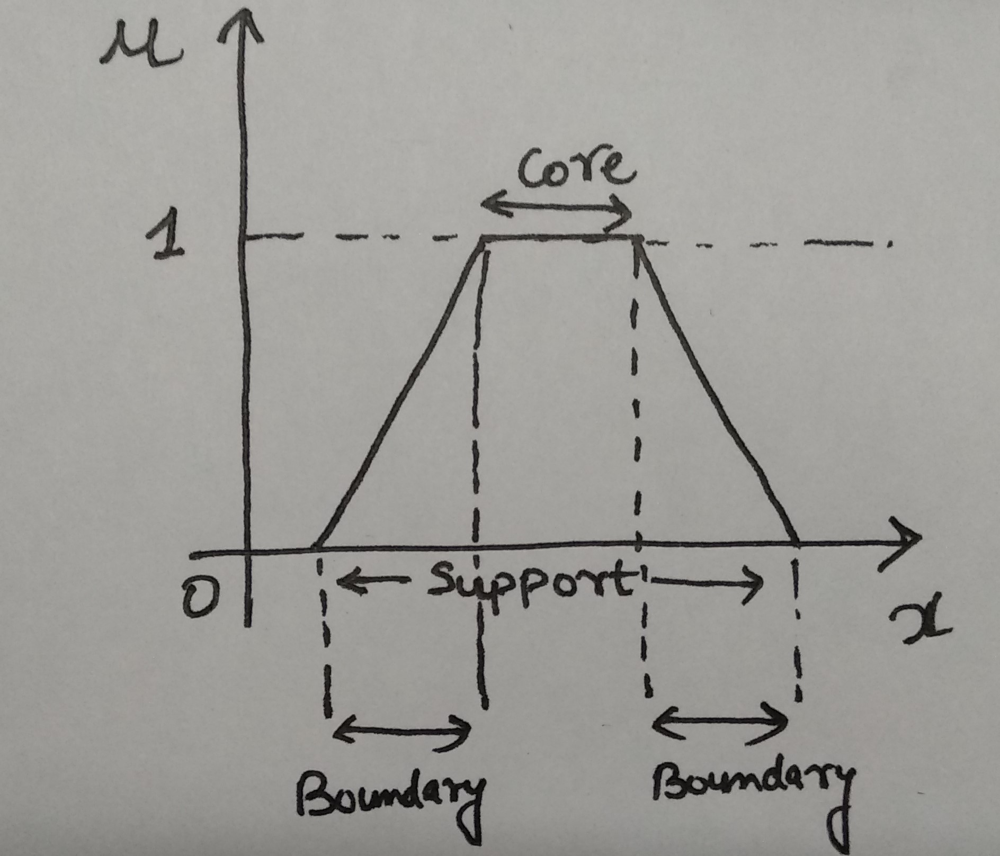
Boundary
For any fuzzy set Ã, the boundary of a membership function is the region of universe that is characterized by a nonzero but incomplete membership in the set. Hence, core consists of all those elements x of the universe of information such that,
1 > µ_{A} > 0

Slide 15
Fuzzy Inference System
Fuzzy Inference System is the key unit of a fuzzy logic system having decision making as its primary work.
It uses the “IF…THEN” rules along with connectors “OR” or “AND” for drawing essential decision rules.
Characteristics of Fuzzy Inference System
The output from FIS is always a fuzzy set irrespective of its input which can be fuzzy or crisp.
It is necessary to have fuzzy output when it is used as a controller.
A defuzzification unit would be there with FIS to convert fuzzy variables into crisp variables.

Slide 16
Functional Blocks of FIS
Rule Base − It contains fuzzy IF-THEN rules.
Database − It defines the membership functions of fuzzy sets used in fuzzy rules.
Decision-making Unit − It performs operation on rules.
Fuzzification Interface Unit − It converts the crisp quantities into fuzzy quantities.
Defuzzification Interface Unit − It converts the fuzzy quantities into crisp quantities. Following is a block diagram of fuzzy interference system.

Slide 17
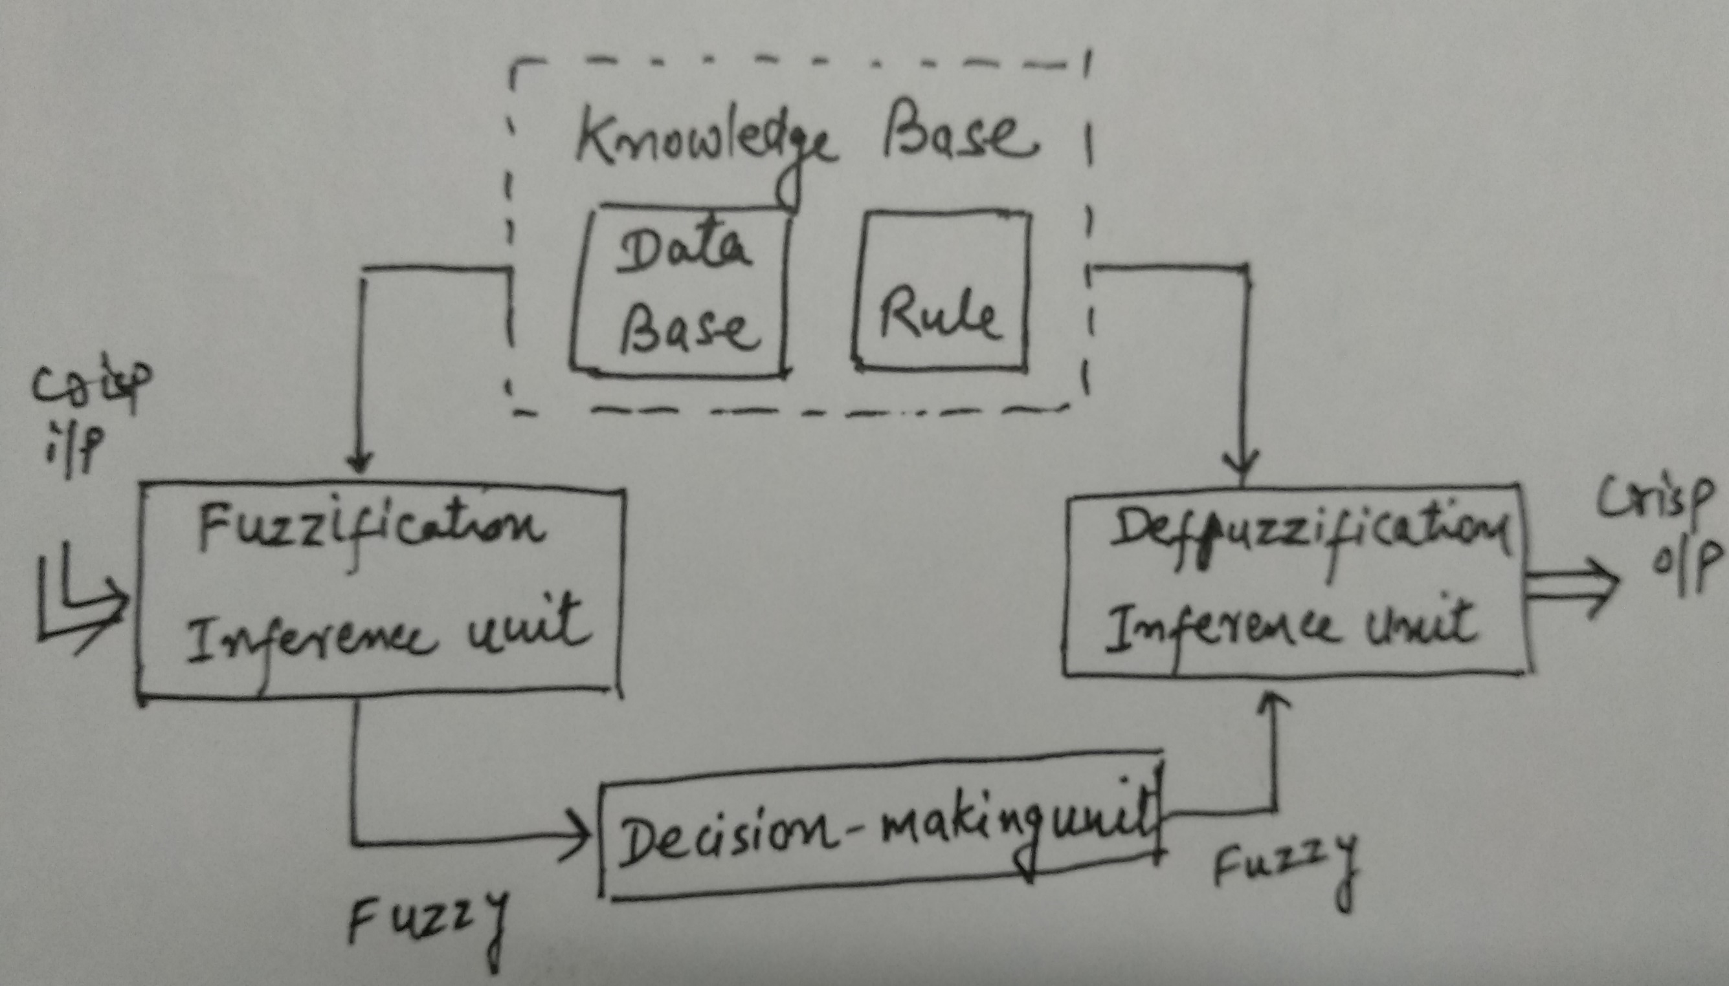

Slide 18
Working of FIS
A fuzzification unit supports the application of numerous fuzzification methods, and converts the crisp input into fuzzy input.
A knowledge base - collection of rule base and database is formed upon the conversion of crisp input into fuzzy input.
The defuzzification unit fuzzy input is finally converted into crisp output.
Methods of FIS
Following are the two important methods of FIS, having different consequent of fuzzy rules-
Mamdani Fuzzy Inference System.
Takagi-Sugeno Fuzzy Model (TS Method).

Slide 19
Fuzzification
Fuzzification is the first step in the fuzzy inferencing process. This involves a domain transformation where crisp inputs are transformed into fuzzy inputs.
Crisp inputs are exact inputs measured by sensors and passed into the control system for processing, such as temperature, pressure, rpm's, etc.
Each crisp input that is to be processed by the FIS has its own group of membership functions or sets to which they are transformed.
This group of membership functions exists within a universe of discourse that holds all relevant values that the crisp input can possess.

Slide 20
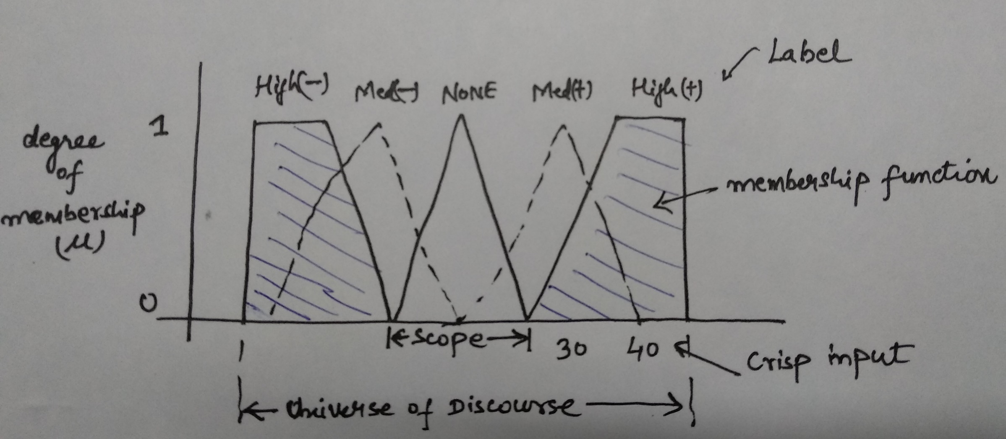
The following shows the structure of membership functions within a universe of discourse for a crisp input.

Slide 21
label: descriptive name used to identify a membership function.
scope: or domain, the width of the membership function, the range of concepts, usually numbers, over which a membership function is mapped.
crisp inputs: distinct or exact inputs to a certain system variable, usually measured parameters external from the control system.
When designing the number of membership functions for an input variable, labels must initially be determined for the membership functions. The number of labels correspond to the number of regions that the universe should be divided, such that each label describes a region of behavior. A scope must be assigned to each membership function that numerically identifies the range of input values that correspond to a label.

Slide 22
When considering the number of membership functions to exist within the universe of discourse, one must consider that:
i) too few membership functions for a given application will cause the response of the system to be too slow and fail to provide sufficient output control in time to recover from a small input change. This may also cause oscillation in the system.
ii) too many membership functions may cause rapid firing of different rule consequents for small changes in input, resulting in large output changes, which may cause instability in the system.
These membership functions should also be overlapped. No overlap reduces a system based on Boolean logic. Every input point on the universe of discourse should belong to the scope of at least one but no more than two membership function

Slide 23
No two membership functions should have the same point of maximum truth, (1). When two membership functions overlap, the sum of truths or grades for any point within the overlap should be less than or equal to 1.
Overlap should not cross the point of maximal truth of either membership function.
Marsh has proposed two indices to describe the overlap of membership functions quantitatively. These are overlap ratio and overlap robustness.

Slide 24
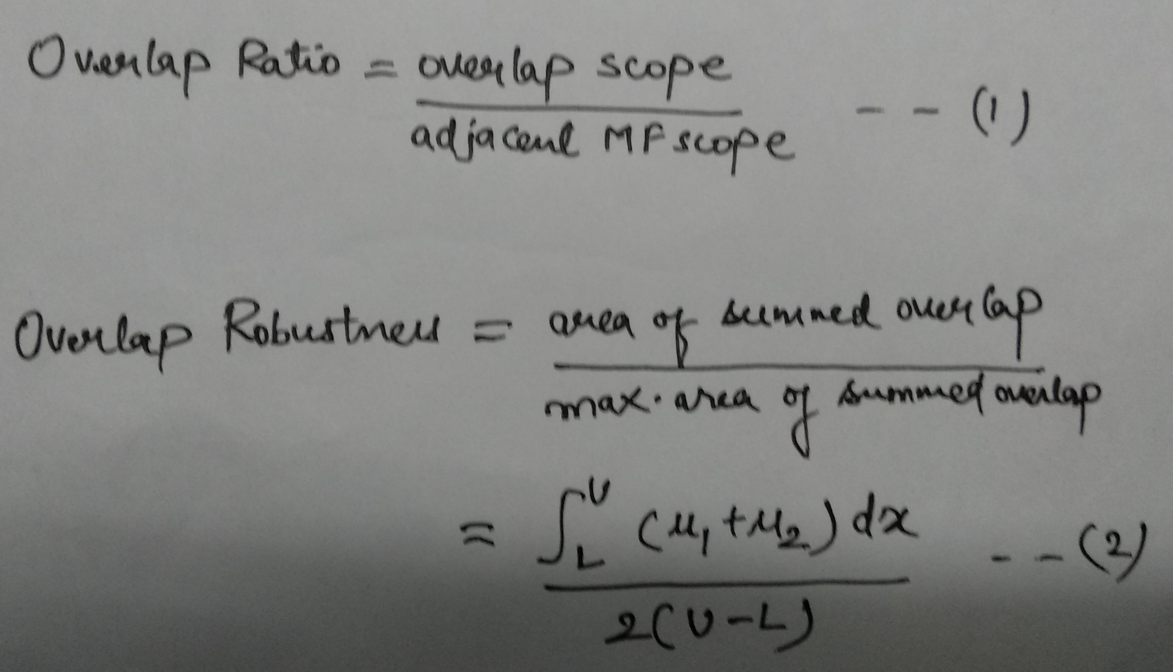

Slide 25
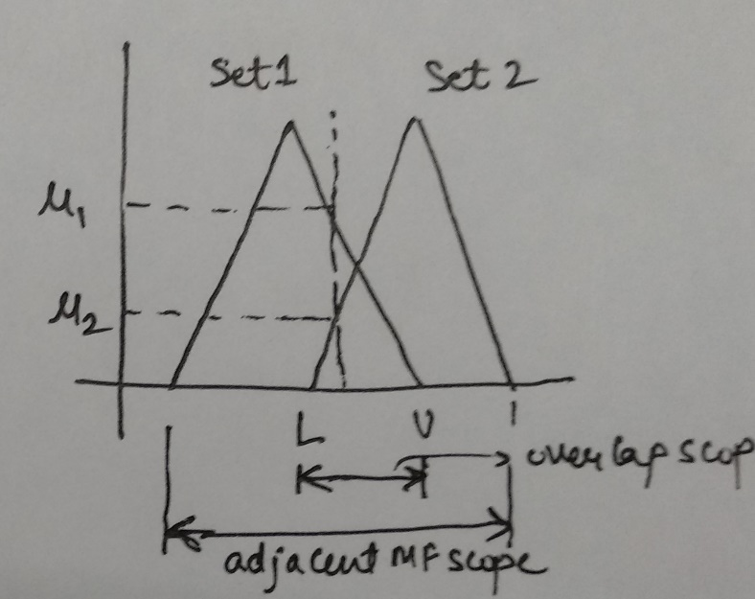
The fuzzification process maps each crisp input on the universe of discourse, and its intersection with each membership function is transposed onto the µ axis as illustrated in the previous figure. These µ values are the degrees of truth for each crisp input and are associated with each label as fuzzy inputs. These fuzzy inputs are then passed on to the next step, Rule Evaluation.

Slide 26
Defuzzification
Defuzzification involves the process of transposing the fuzzy outputs to crisp outputs. There are a variety of methods to achieve.
The process of reducing a fuzzy set into a crisp set or to convert a fuzzy member into a crisp member.
We have already studied that the fuzzification process involves conversion from crisp quantities to fuzzy quantities. In a number of engineering applications, it is necessary to defuzzify the result or rather “fuzzy result” so that it must be converted to crisp result. Mathematically, the process of Defuzzification is also called “rounding it off”.
A method of averaging is utilized here, and is known as the Center of Gravity method or COG, it is a method of calculating centroids of sets.

Slide 27
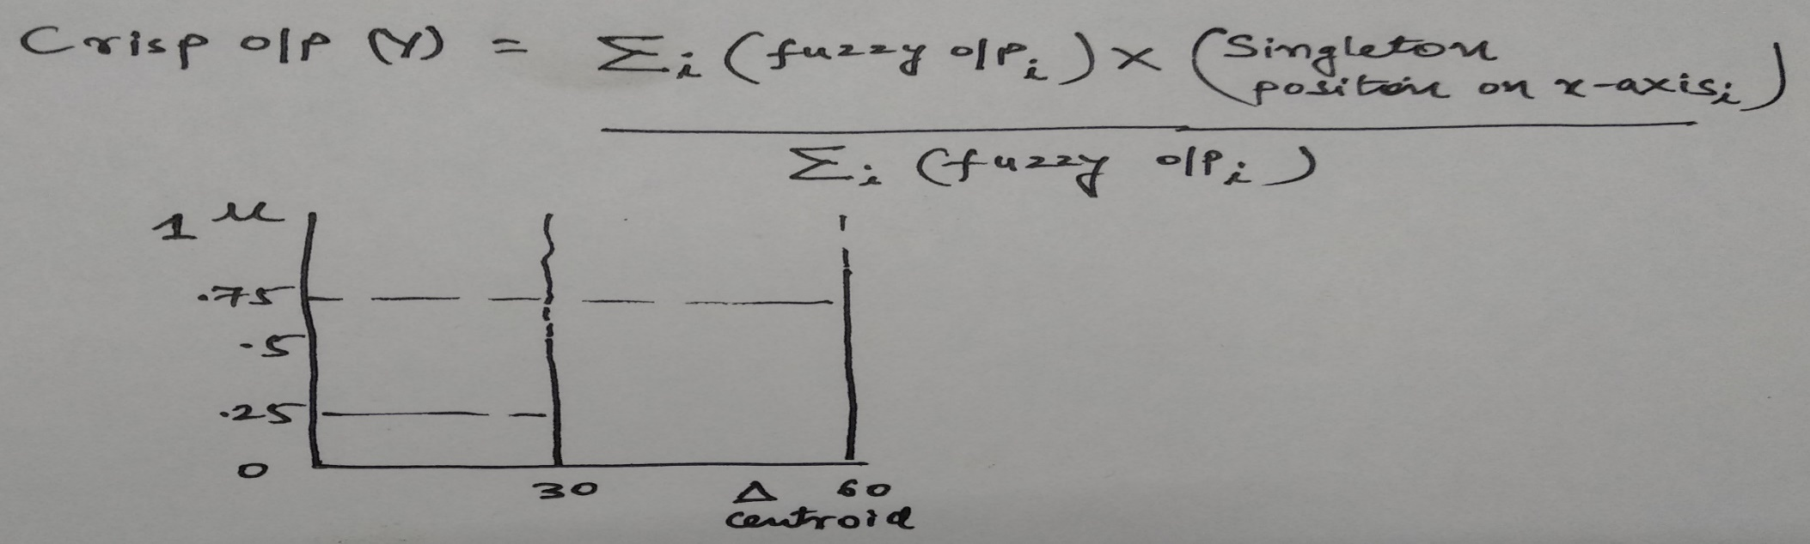
The output membership functions to which the fuzzy outputs are transposed are restricted to being singletons. This is so to limit the degree of calculation intensity in the microcontroller. The fuzzy outputs are transposed to their membership functions similarly as in fuzzification. With COG the singleton values of outputs are calculated using a weighted average. The crisp output is the result and is passed out of the fuzzy inferencing system for processing elsewhere.

Slide 28
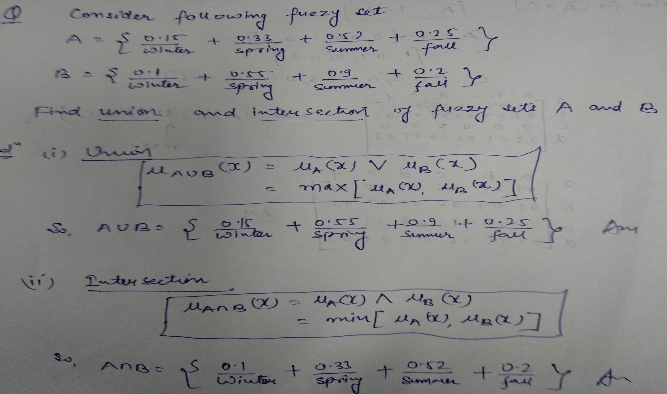
NUMERICALS

Slide 29
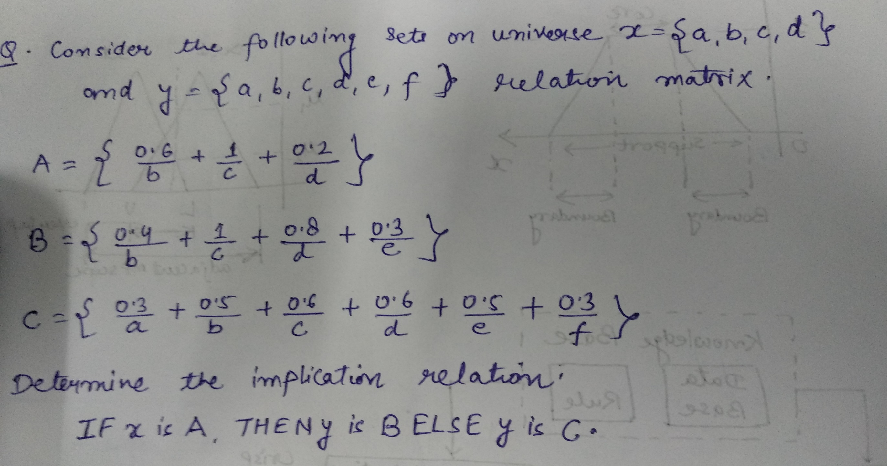
Ex2

Slide 30
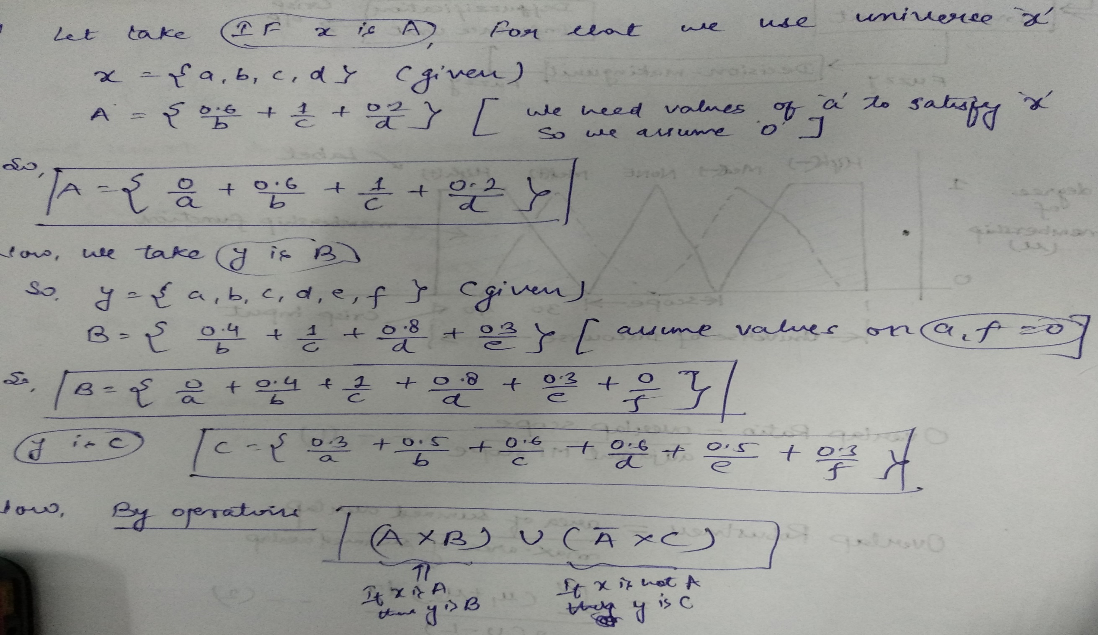
Sol2

Slide 31
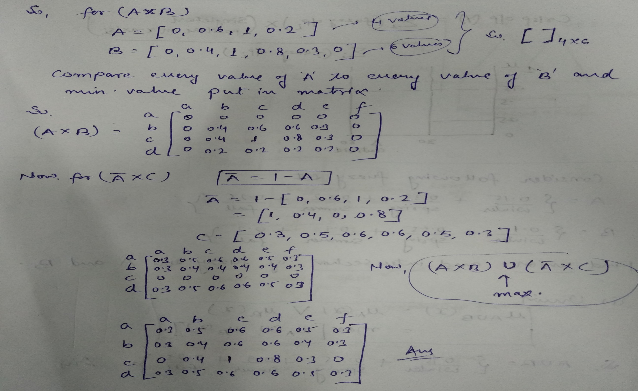

Slide 32
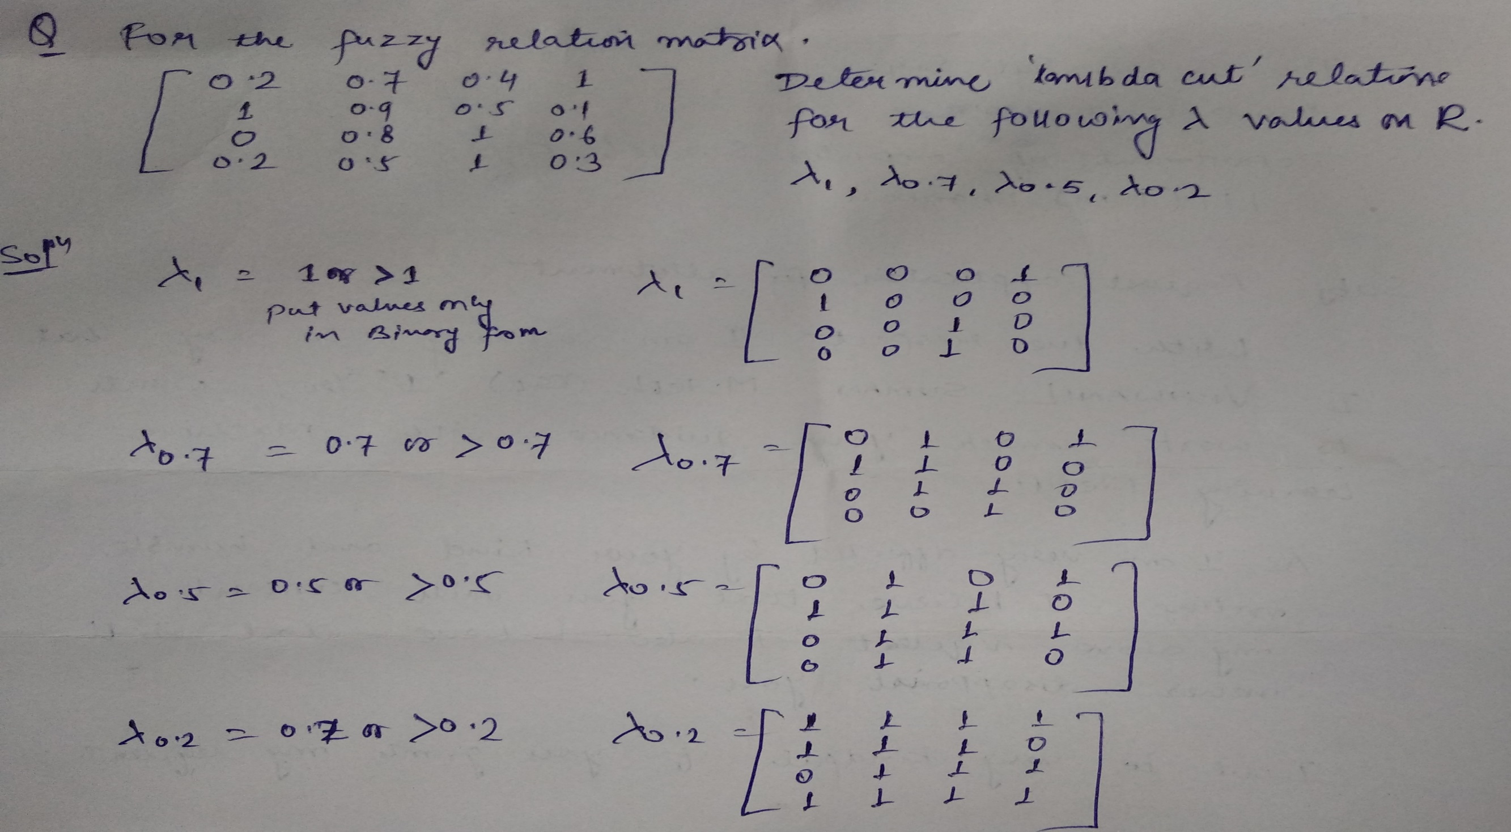
Ex3

Slide 33
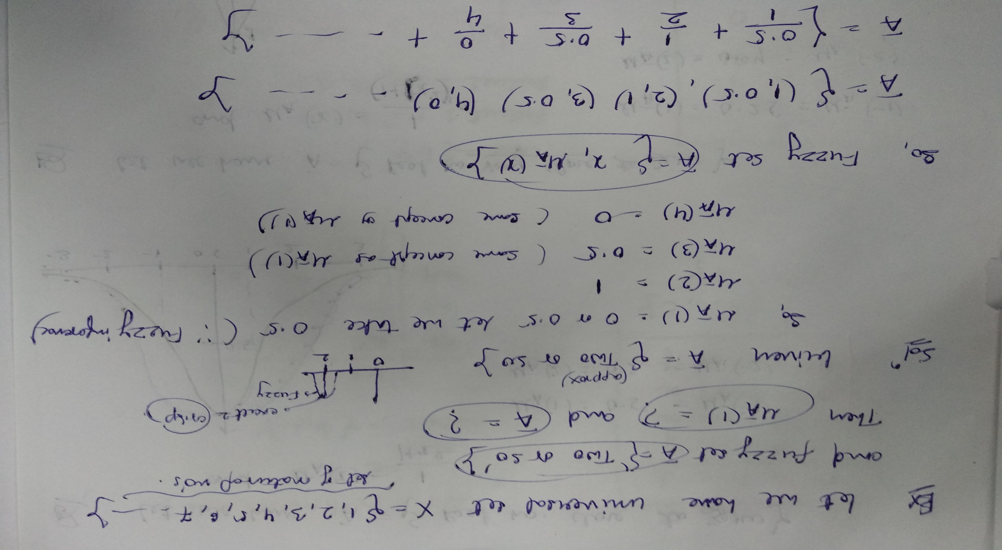
Ex4

Slide 34
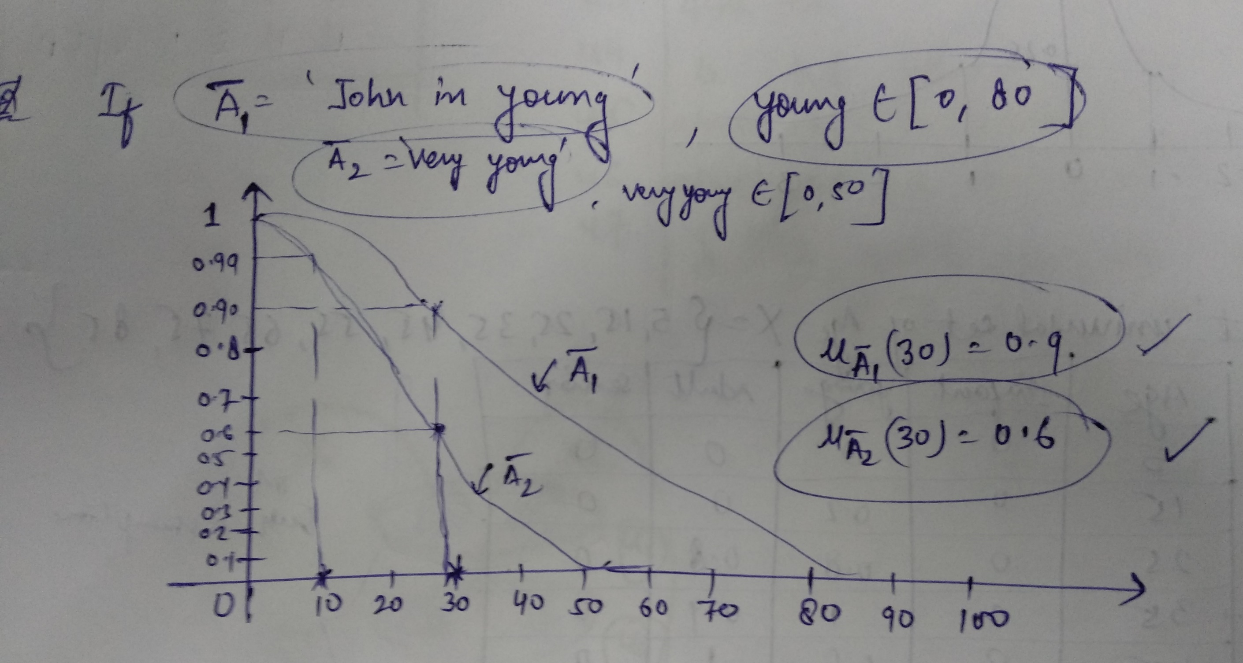
Ex5

Slide 35
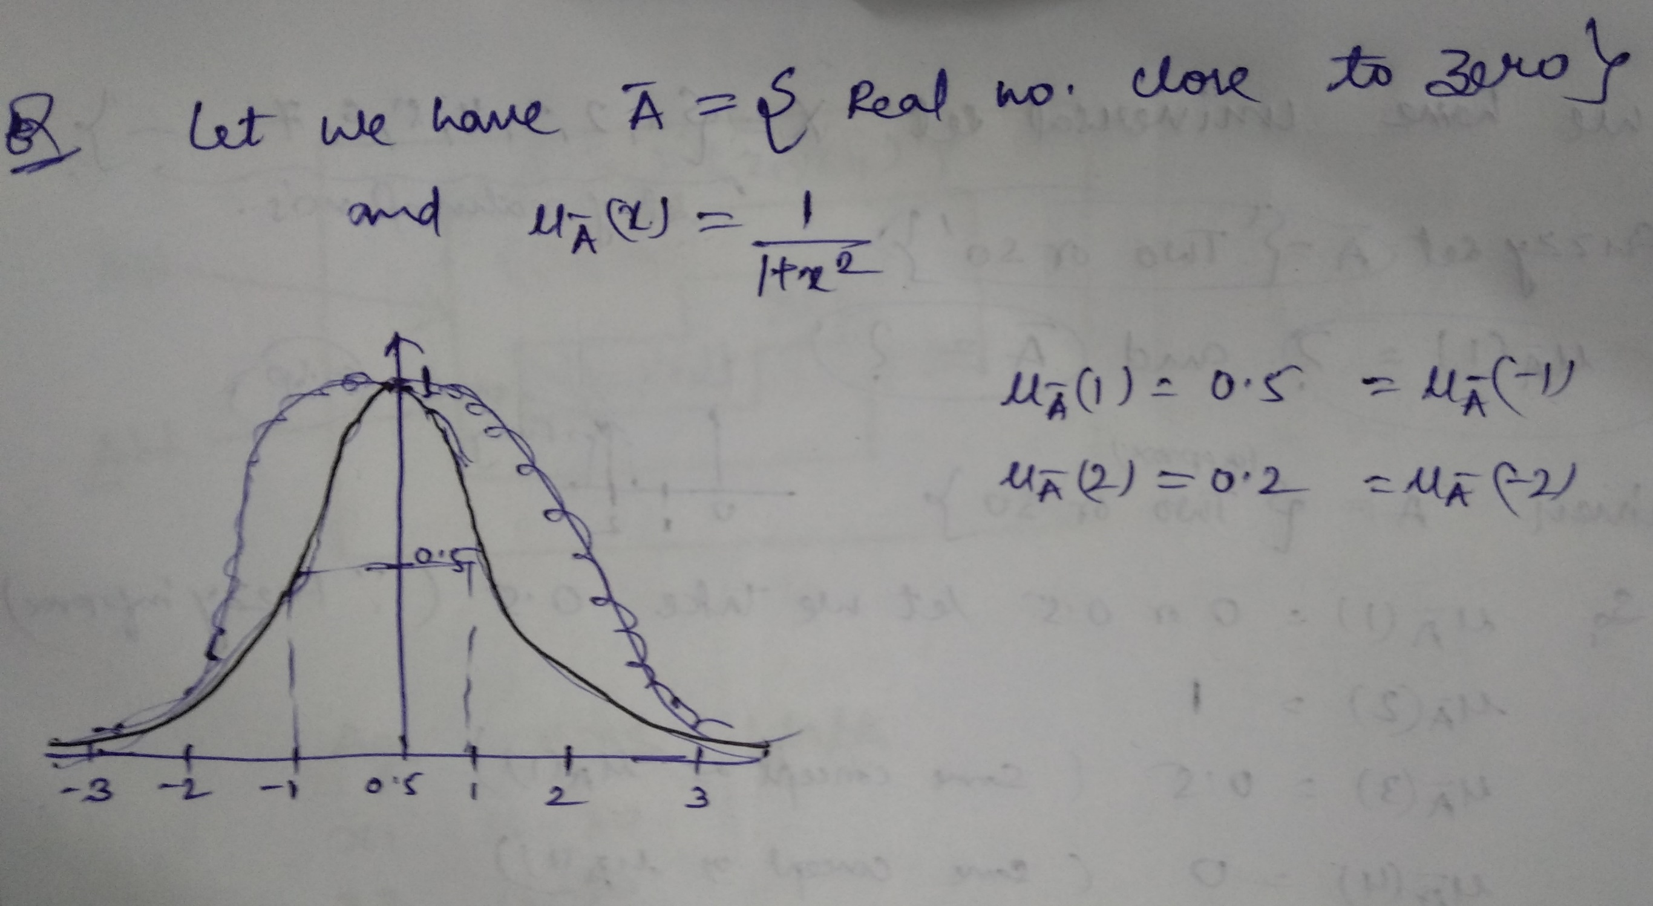
Ex6

Slide 36
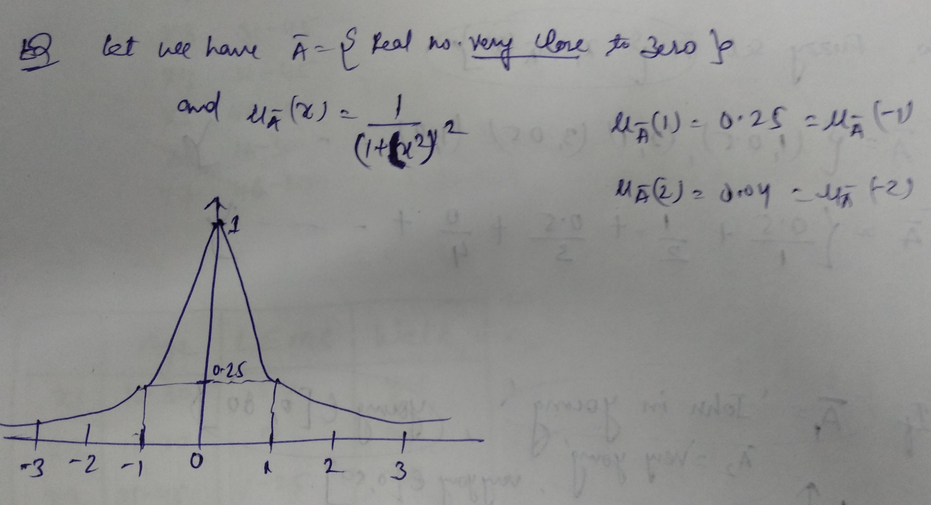
Ex7

Slide 37
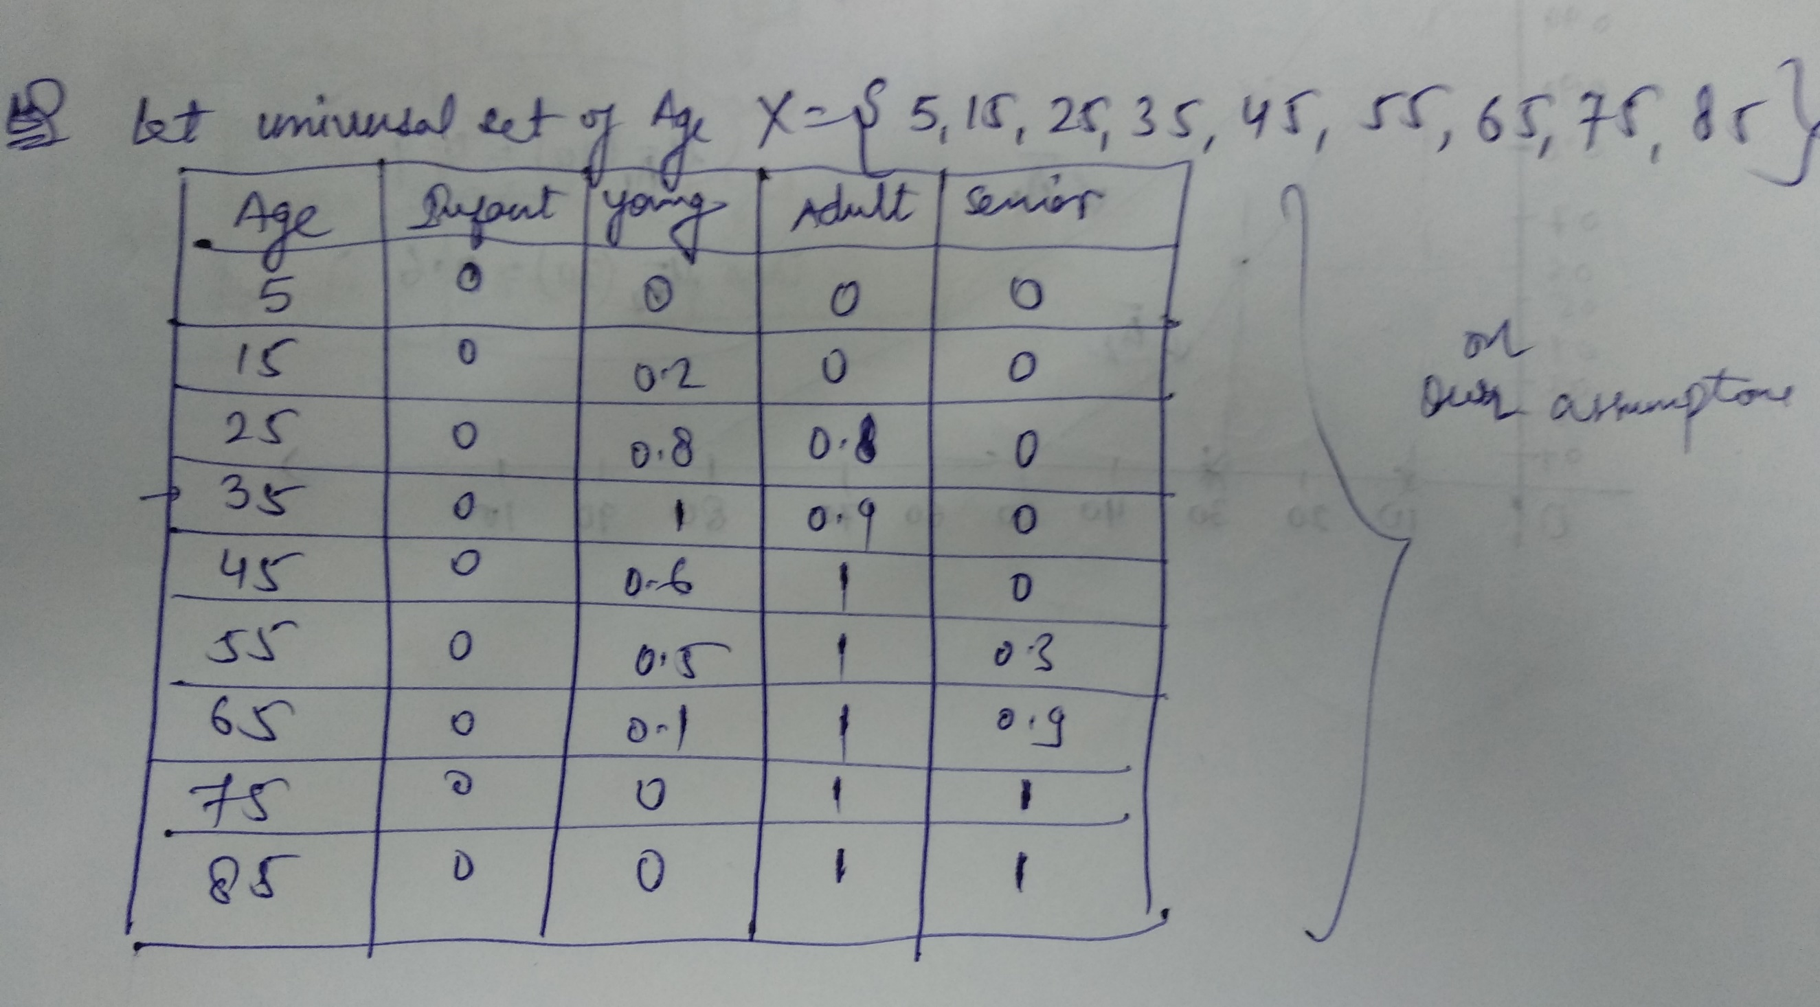
Ex8

Slide 38
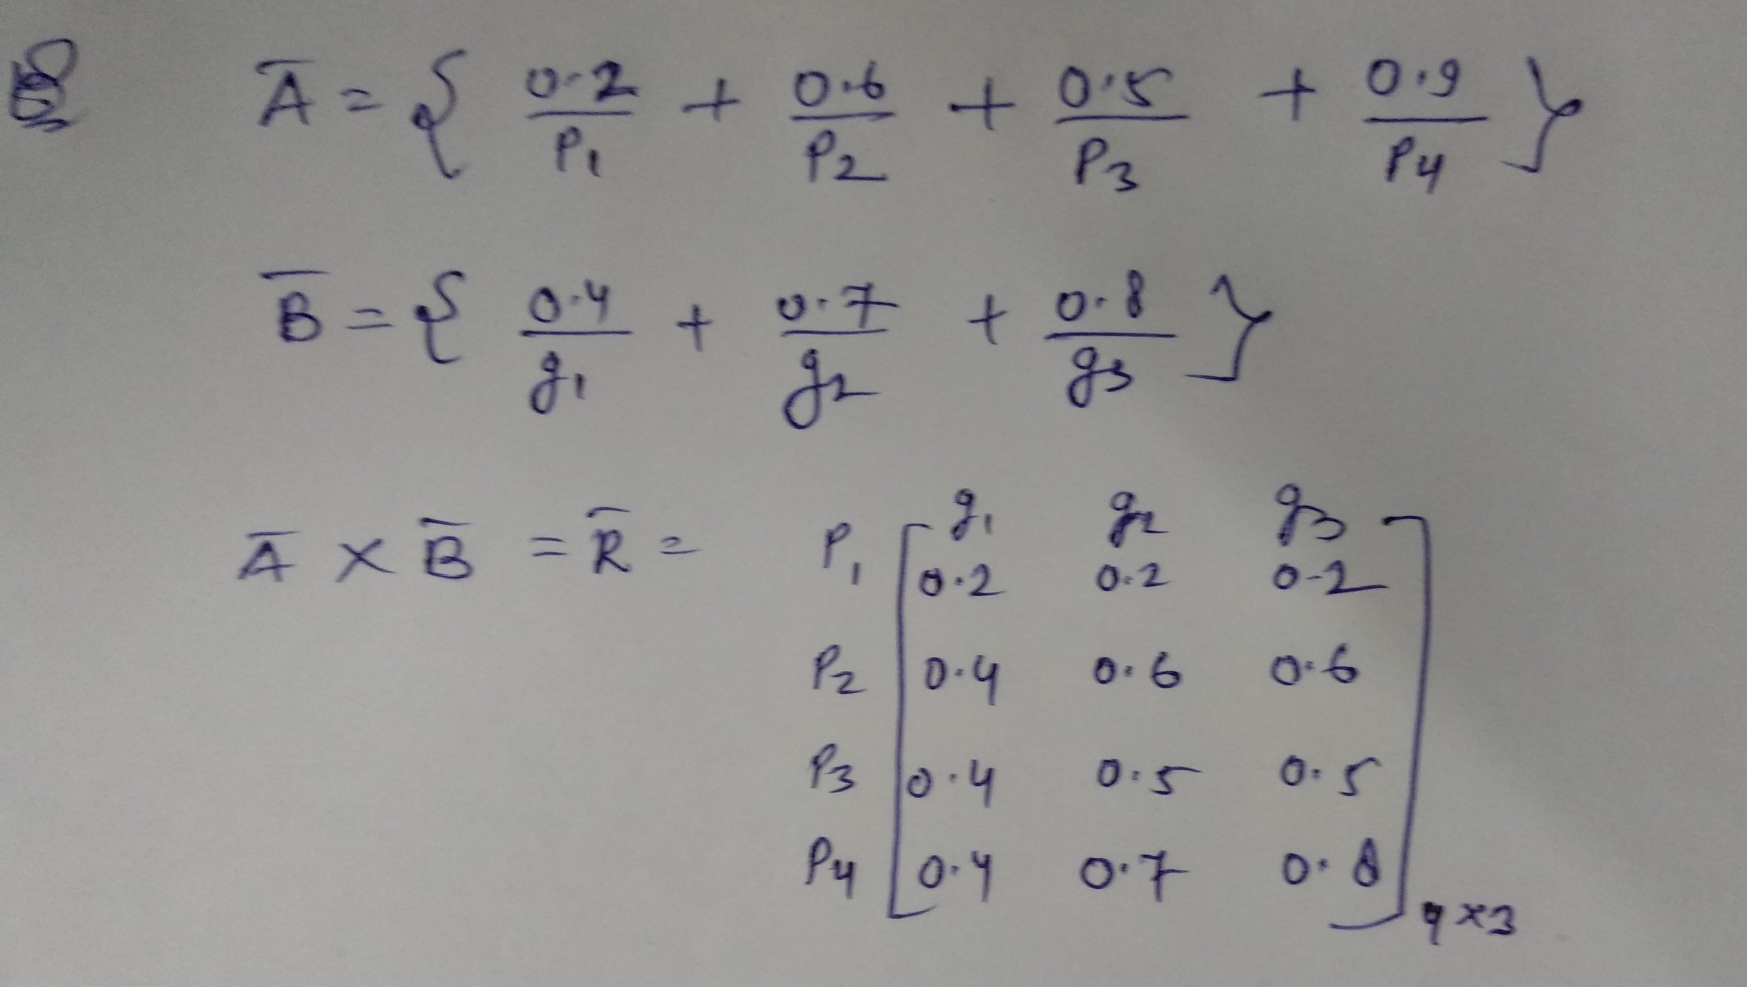
Ex9

Slide 39
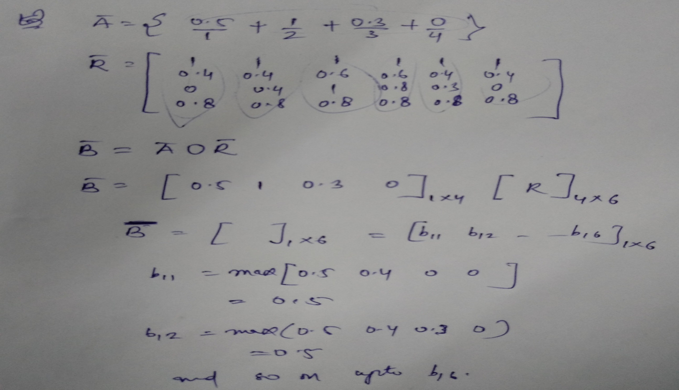
Ex10

